Slide 1

RxLogix Corporation
Introduction to Groovy
Introduction To Groovy
Presented By: Sargam Sachdeva
Presented By: Gautam Malhotra

Slide 2
6/24/16
Agenda
What is Groovy?
History of Groovy.
Why Groovy?
Setup Groovy
Groovy Shell?
Groovy Console.
What do we mean by Dynamic typing in Groovy?
Closure in Groovy.
Comparison between Java and Groovy with examples.
What is GDK?

Slide 3
6/24/16
Agenda
Strings in Groovy:
Strings.
Multiline Strings.
GString.
Operator overloading in Groovy.
What is Groovy Truth?
Groovy Classes
Working with files.

Slide 4
6/24/16
6/24/16
What is Groovy?
Is a powerful, dynamic language for the Java platform inspired by languages like Ruby, Python, Smalltalk etc making similar features available to Java developers in a Java like syntax.

Slide 5
6/24/16
What is Groovy?
Dynamic : Dynamically Typed, supports Metaprogramming.
Java Platform : Compiles to a bytecode
Java Syntax : Very similar to Java.

Slide 6
6/24/16
History of Groovy
Started by James Strachan and Bob McWhirter in 2003.
Guillaume Laforge and Jeremy Rainer took it forward.
Groovy 1.0 release in 2007.
Now in version 2.4

Slide 7
6/24/16
Why Groovy?
Feels like Java, with no boilerplate code.
Flat learning curve.
Dynamic.
Extends JDK.

Slide 8
6/24/16
Why Groovy?
No Unnecessary Code.
Already has features which are yet to be seen in java itself like Closures.
Duck Typing.
Optional Exceptional Handling.

Slide 9
6/24/16
Groovy : Duck Typing
Duck Typing refers to the concept that : If it walks like a duck, and talks like a duck, it must be a duck. In Groovy, If an object has properties and method similar to another object, the two objects must be of same type.
Objects are polymorphic without being related by a common base class or interface.
Allows for greater flexibility in polymorphism.
Relaxes typing requirements.

Slide 10
6/24/16
Groovy : Duck Typing (Example)
class User {
String firstName
String middleInitial
String lastName
}
def user = new User(firstName: "Dan", lastName: "Woods")
assert user.firstName == "Dan"

Slide 11
6/24/16
Optional Parameters
Groovy allows to have optional parameter values.
def sum(a,b,c=0){
a+b+c;
}
println sum(1,2)
println sum(1,2,3)

Slide 12
6/24/16
Groovy : Setup
Download the binary from http://groovy.codehaus.org
Install JDK > 1.5
Set GROOVY_HOME to point to the installation.
Add GROOVY_HOME/bin to the path variable.

Slide 13
6/24/16
Groovy : Shell
Open a terminal window and type “groovysh”.
Command line.
It allows easy access to evaluate Groovy expressions, and run simple experiments.

Slide 14
6/24/16
Groovy : Console
Allows a user to enter and run Groovy scripts
You can save your scripts, open existing scripts etc
Groovy Web Console
http://groovyconsole.appspot.com

Slide 15
6/24/16
Groovy : Closures
A Closure is a block of code given a name or piece of code that is defined and then executed at a later point.
It has some special properties like implicit variables.
Groovy closures can't stand alone: they're either attached to a method or assigned to a variable. e.g.: def variable = { println "Closure"}
Groovy feature that will be used the most.
Methods can accept closure as parameters.

Slide 16
Implicit parameter
When a closure does not explicitly define a parameter list (using ->), a closure always defines an implicit parameter, named it. This means that this code:
def greeting = { "Hello, $it!" }
assert greeting('Patrick') == 'Hello, Patrick!'
is stricly equivalent to this one:
def greeting = { it -> "Hello, $it!" }
assert greeting('Patrick') == 'Hello, Patrick!'
If you want to declare a closure which accepts no argument and must be restricted to calls without arguments, then you must declare it with an explicit empty argument list:
def magicNumber = { -> 42 }
// this call will fail because the closure doesn't accept any argument
magicNumber(11)

Slide 17
def closureWithOneArg = { str -> str.toUpperCase() }
assert closureWithOneArg('groovy') == 'GROOVY'
def closureWithOneArgAndExplicitType = { String str -> str.toUpperCase() }
assert closureWithOneArgAndExplicitType('groovy') == 'GROOVY'
def closureWithTwoArgs = { a,b -> a+b }
assert closureWithTwoArgs(1,2) == 3

Slide 18
def closureWithTwoArgsAndExplicitTypes = { int a, int b -> a+b }
assert closureWithTwoArgsAndExplicitTypes(1,2) == 3
def closureWithTwoArgsAndOptionalTypes = { a, int b -> a+b }
assert closureWithTwoArgsAndOptionalTypes(1,2) == 3
def closureWithTwoArgAndDefaultValue = { int a, int b=2 -> a+b }
assert closureWithTwoArgAndDefaultValue(1) == 3

Slide 19
6/24/16
Groovy : Example of Closures
//Method Prototype
void method(Integer n , Closure closure)
//Call to method
method(10,{println "hello"})
method(5) {number-> println number}
//if last argument,then:
method(10) { println "Closure"}
[1, 2, 3].each {
println it }

Slide 20
6/24/16
Comparison between Java and Groovy

Slide 21
6/24/16
Java to Groovy
public class Greetings
{
public static void main(String[] args)
{
for(int i = 0; i < 3; i++)
{
System.out.print("hi" );
}
}
}

Slide 22
6/24/16
Java to Groovy
3.times { print 'hi ' }

Slide 23
6/24/16
Java to Groovy
import java.io.*;
class FileTest {
public static void main(String args[]) {
try {
File file = new File(“/Users/gautammalhotra/Desktop/Test.txt");
FileReader fileReader = new FileReader(file);

Slide 24
6/24/16
Java to Groovy
BufferedReader bufferedReader = new BufferedReader(fileReader);
String line = null;
while ((line = bufferedReader.readLine()) != null) {
System.out.println(line);
}
} catch (IOException ioException) {
ioException.printStackTrace();
}
}
}

Slide 25
6/24/16
Java to Groovy
new File(“/Users/gautammalhotra/Desktop/Test.txt").eachLine {line->
println(line)
}

Slide 26
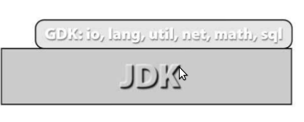
6/24/16
GDK
Enhancement over JDK.
The GDK sits on top of the JDK
Provides new Libraries and APIs to Groovy Developer.

Slide 27
6/24/16
Strings
In groovy , a string can be defined three different ways :
using double quotes, single quotes, or slashes (called
“slashy strings”).
def helloChris = "Hello, Chris"
def helloJoseph = 'Hello, Joseph'
def helloJim = /Hello, Jim/

Slide 28
6/24/16
Multiline Strings
A multiline string is defined by using three double quotes or three single quotes.
Multiline string support is very useful for creating templates or embedded documents (such as XML templates, HTML, and so on).
def multiLineString = """
Hello,
This is a multiline string ......
"""

Slide 29
6/24/16
GString
A GString is just like a normal string, except that it
evaluates expressions that are embedded within the
string,in the form ${...}.
def name = "Jim"
def helloName = "Hello, ${name}"
println helloName // Hello, Jim
println helloName.class.name //org.codehaus.groovy.runtime.GStringImpl

Slide 30
def a = 10
def b = 15
def multilineString = """
The sum of ${a} and ${b}
is ${a+b}
${a} + ${b} = ${a+b}
"""

Slide 31
6/24/16
Operator Overloading
Groovy supports operator overloading which makes working with Numbers, Collections, Maps and various other data structures easier to use.
def date = new Date()
date++
println date
All operators in Groovy are method calls.
Various operators in Groovy are mapped onto regular Java method calls on objects.

Slide 32
6/24/16
Operator Corresponding Method Call
The following few of the operators supported in Groovy and the methods they map to
a + b a.plus(b)
a - b a.minus(b)
a * b a.multiply(b)
a ** b a.power(b)
a / b a.div(b)
a % b a.mod(b)

Slide 33
class Item {
private String name;
private double price;
Item(String name, double price) {
this.name = name
this.price = price
}
def plus(Item other) {
return new Item(this.name + ", " + other.name, this.price + other.price)
}

Slide 34
@Override
public String toString() {
return "Item{" +
"name='" + name + '\'' +
", price=" + price +
'}';
}
}
def item1 = new Item("Laptop", 500)
def item2 = new Item("Monitor", 350)
def item3 = item1 + item2
println item3

Slide 35
6/24/16
Groovy Truth
In Groovy you can use objects in if and while expressions.
A non-null and non-empty string will evaluate to true.
if("John" ) // any non-empty string is true
if(null) // null is false
if("" ) // empty strings are false
Non zero numbers will evaluate to true.
If(1) // any non-zero value is true
If(-1) // any non-zero value is true
If(0) // zero value is false

Slide 36
6/24/16
Groovy Truth .........
A non-empty collection will evaluate to true.
List family = ["John" , "Jane" ]
if(family) // true since the list is populated.
And Empty Collection will evaluate to false
List family = [ ]
if(family) // false since the map is not populated.
https://riptutorial.com/groovy/topic/5117/groovy-truth--true-ness-

Slide 37
6/24/16
Groovy Classes
In Groovy Classes by default things are public unless you specify otherwise.
Class Person {
String name
Integer age
}
Person person = new Person()
person.name = “Per”
person.age =30

Slide 38
6/24/16
Groovy Classes
Class Person {
String name
Integer age
public void setName(String name) { // Added by default
this.name =name
}
public int getName(){ // Added by Default
return name
}
}

Slide 39
6/24/16
Groovy Classes
person.name = “Groovy” is calling person.setName(“Groovy”) behind the scenes.

Slide 40
6/24/16
Suppressing getters and Setters
To protect a private field from accidental modification in Groovy, you can add a pair of do-nothing getters and setters.
void getName(){}
void setName(String name){}

Slide 41
6/24/16
Constructor
Person person = new Person(name:”Groovy”, age:20)
Person x = new Person()

Slide 42
6/24/16
Working With Files
new File("foo.txt").text
new File("foo.txt").bytes
File("foo.txt").readLines()
File("foo.txt").text="abc"
File("foo.txt").append("abc")
File("foo.txt").eachLine { line -> println(line) }
dir.eachFile
dir.eachDir
dir.eachFileRecurse
http://groovy.codehaus.org/groovy-jdk/java/io/File.html

Slide 43

6/24/16
Questions??

Slide 44
6/24/16
References
http://docs.groovy-lang.org/latest/html/documentation/index.html#groovy-operators
http://java.ociweb.com/javasig/knowledgebase/2006-12/GroovyIntro.pdf
http://tedwise.com/files/GroovyinAction,SecondEdition.pdf
https://en.wikipedia.org/wiki/Dynamic_programming_language
https://en.wikipedia.org/wiki/Java_(programming_language)
https://en.wikipedia.org/wiki/Type_system#DYNAMIC
https://en.wikipedia.org/wiki/Category:Statically_typed_programming_languages
https://en.wikipedia.org/wiki/Boilerplate_code
http://onestepback.org/articles/groovy/ducktyping.html

Slide 45
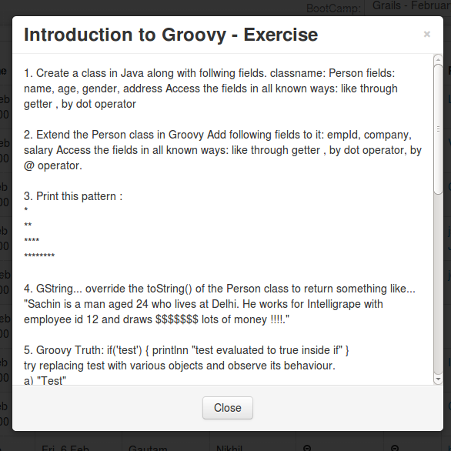
6/24/16
Exercise

Slide 46
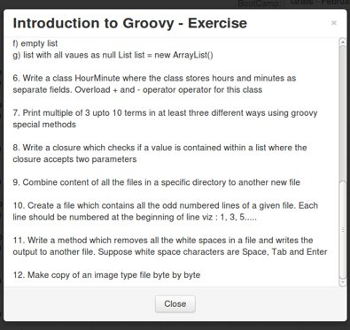

Slide 47

6/24/16
Thank You!

